Slide 1


Market Risk Management
Group
Report Date - July 21, 2000
Confidential

Slide 2
Market Risk Management
Project Objective:
Our review was designed to identify and test the key policies, procedures, and controls related to the Market Risk Management Group’s responsibility to identify market risks, report market risks to management, and administer the Enron Corp. Risk Management Policy.
AA Team Members: Enron Team Members:
John Sorrells Ted Murphy
Jennifer Stevenson Vladimir Gorny
Matthew Nicklos Rudi Zipter
Sharon Smith Matthew Adams

Slide 3
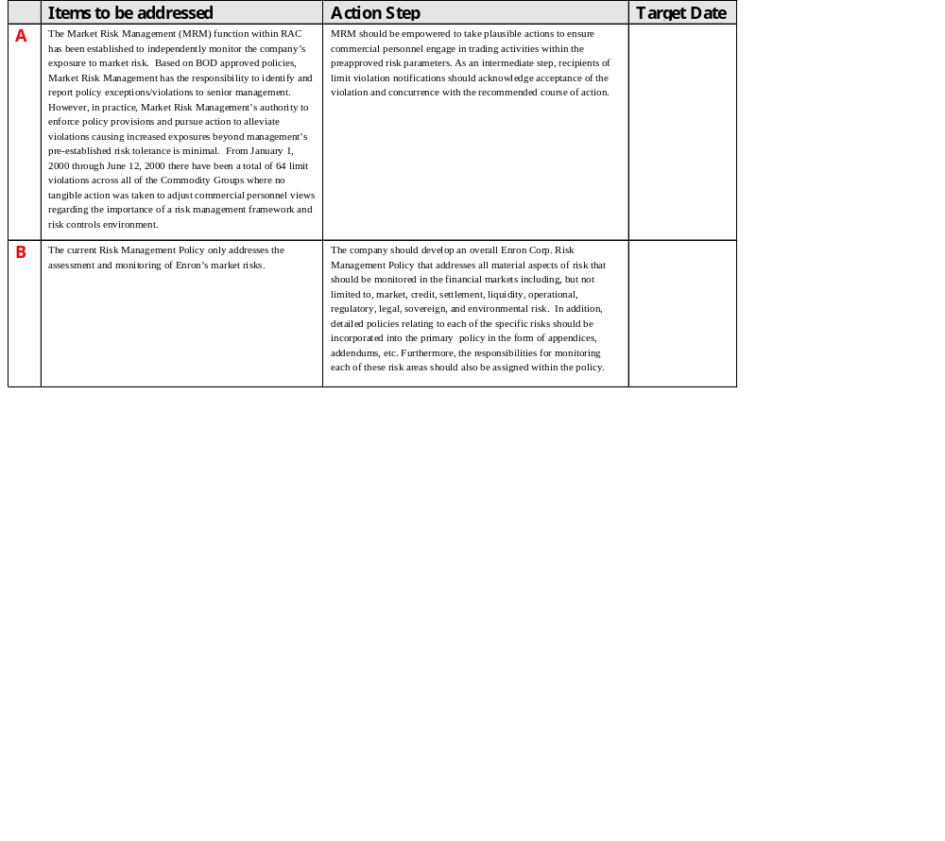
Market Risk Management Observations

Slide 4
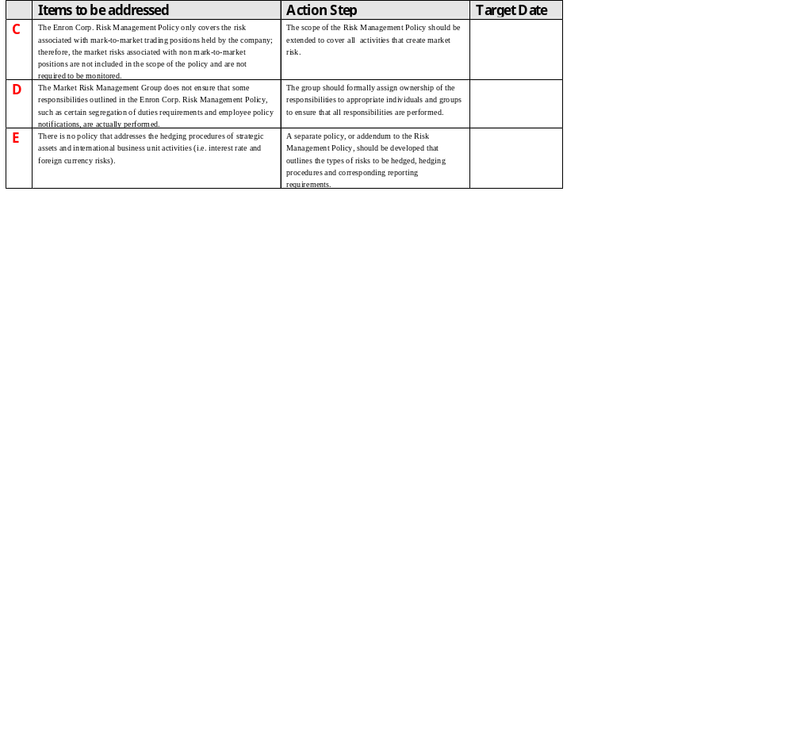
Market Risk Management Observations

Slide 5
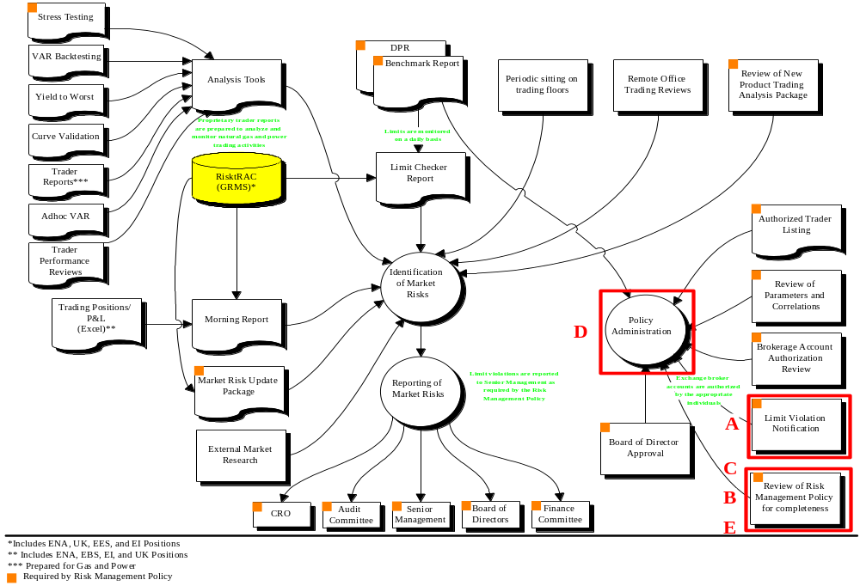
Market Risk Management

Slide 6
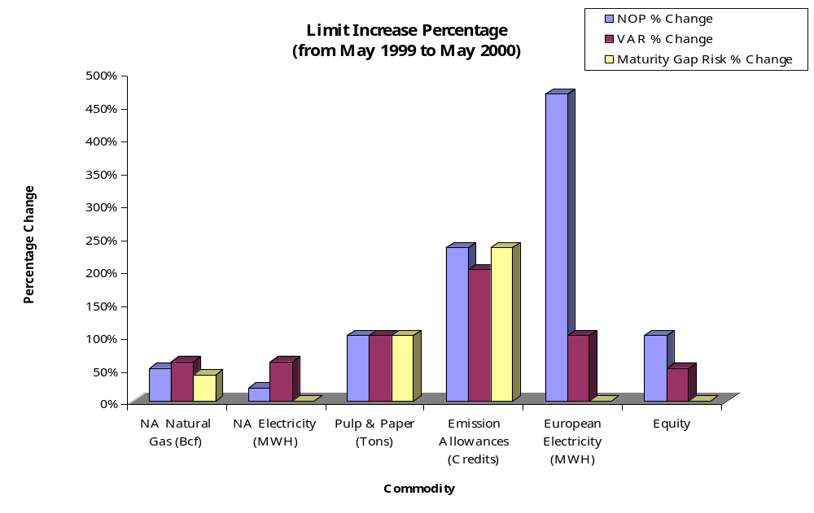
Market Risk Management

Slide 7
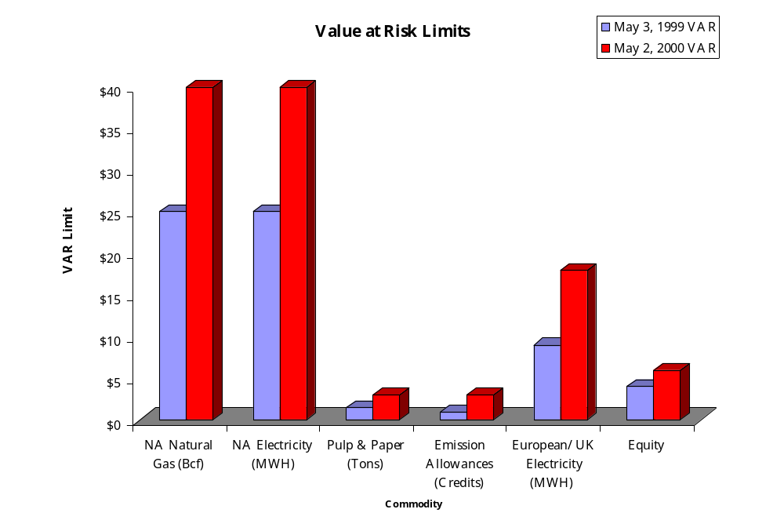
Market Risk Management

